Slide 1

Bounding
John Nganga

Slide 2
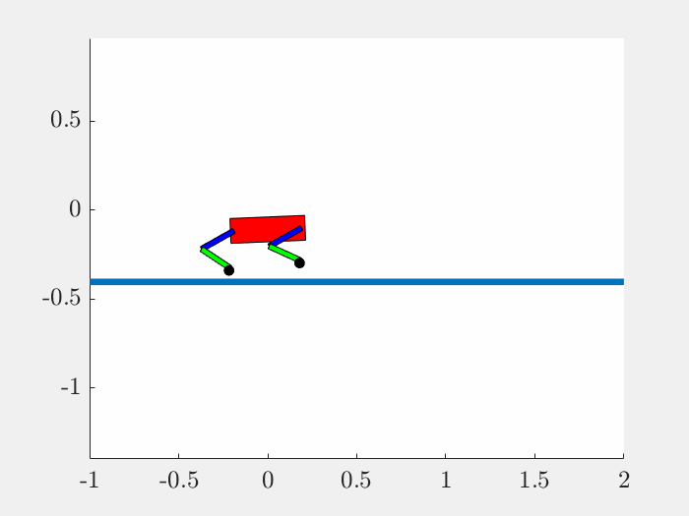
Motion
iLQR
Explicit DDP
Bounding with vx = 0.5

Slide 3
Motion
ExtMod DDP
Tensor DDP

Slide 4
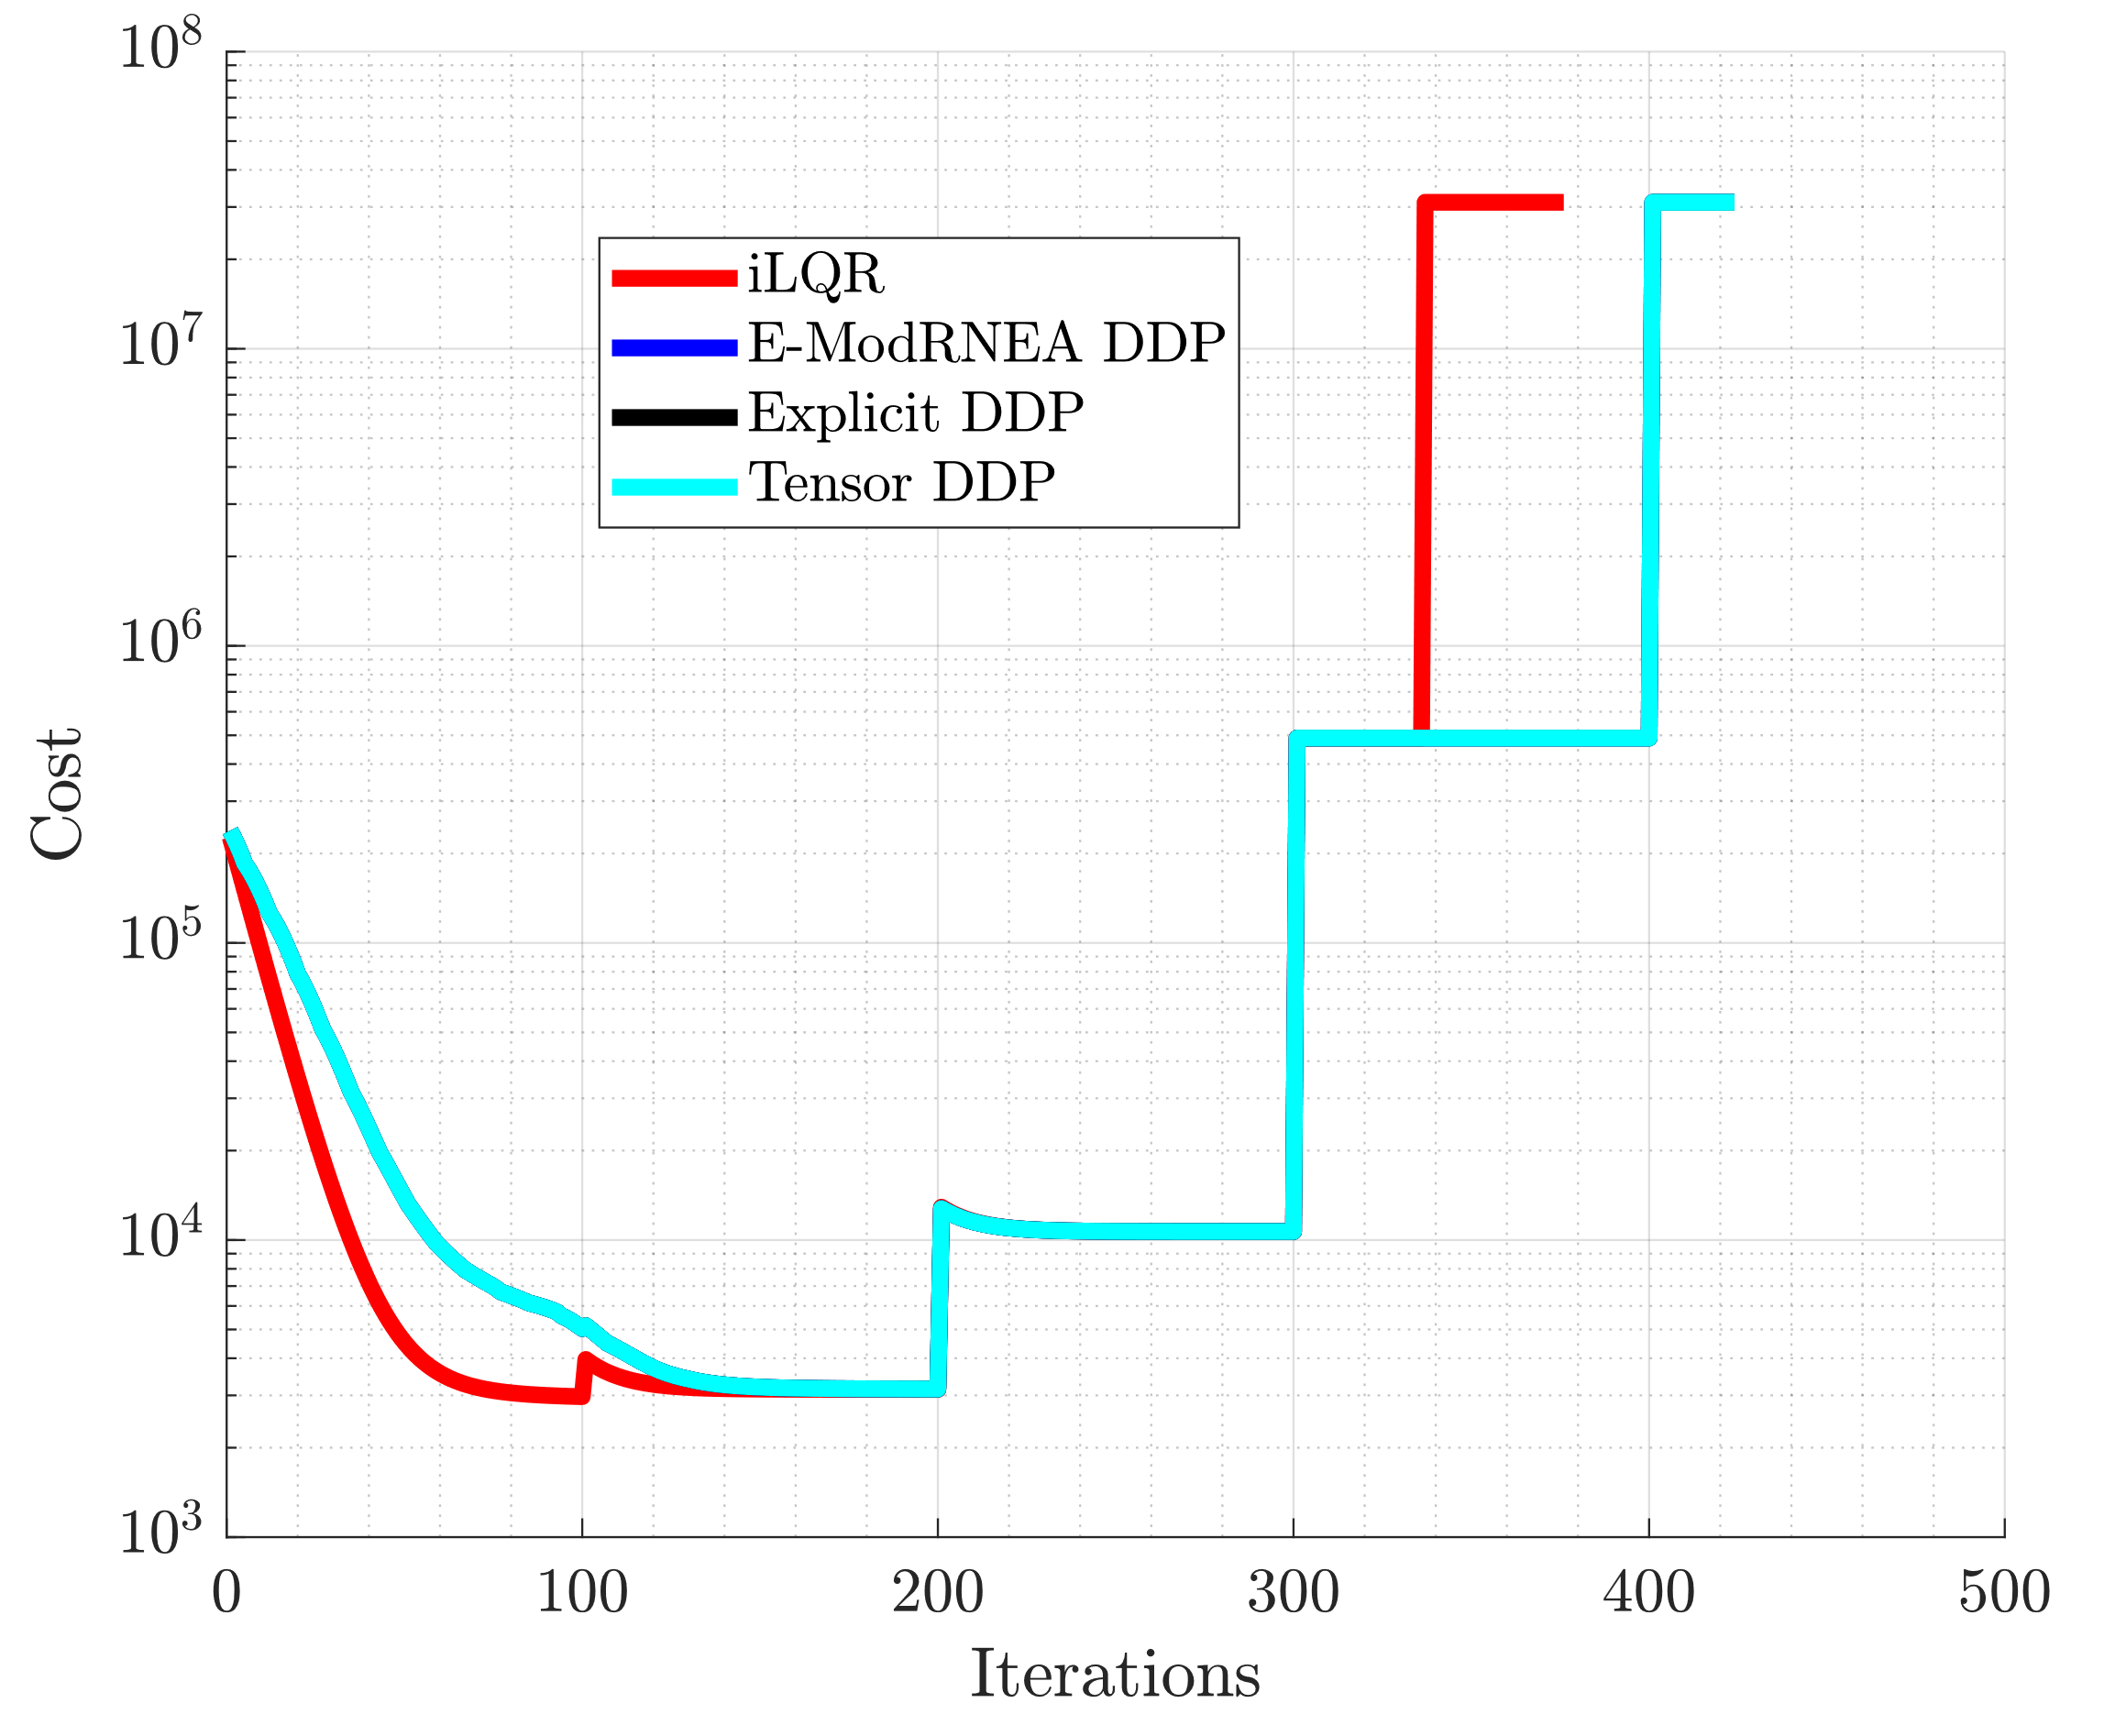
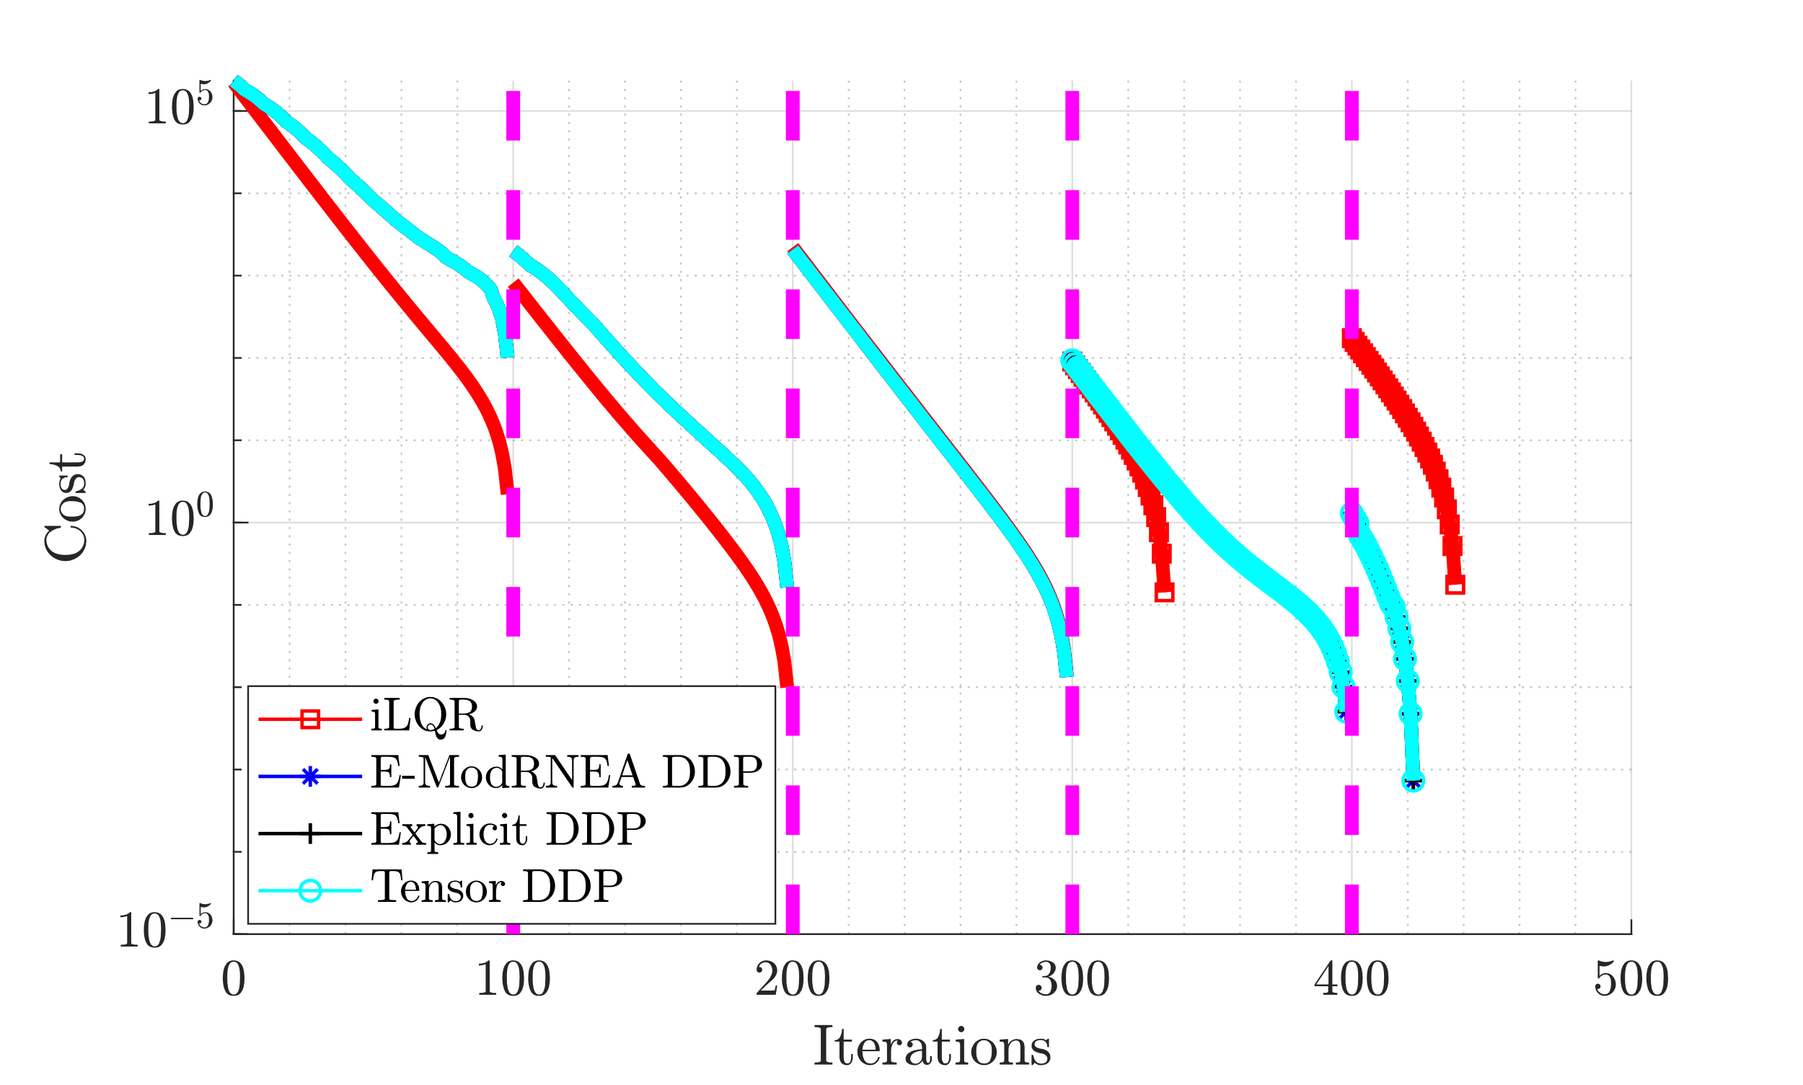
Cost

Slide 5
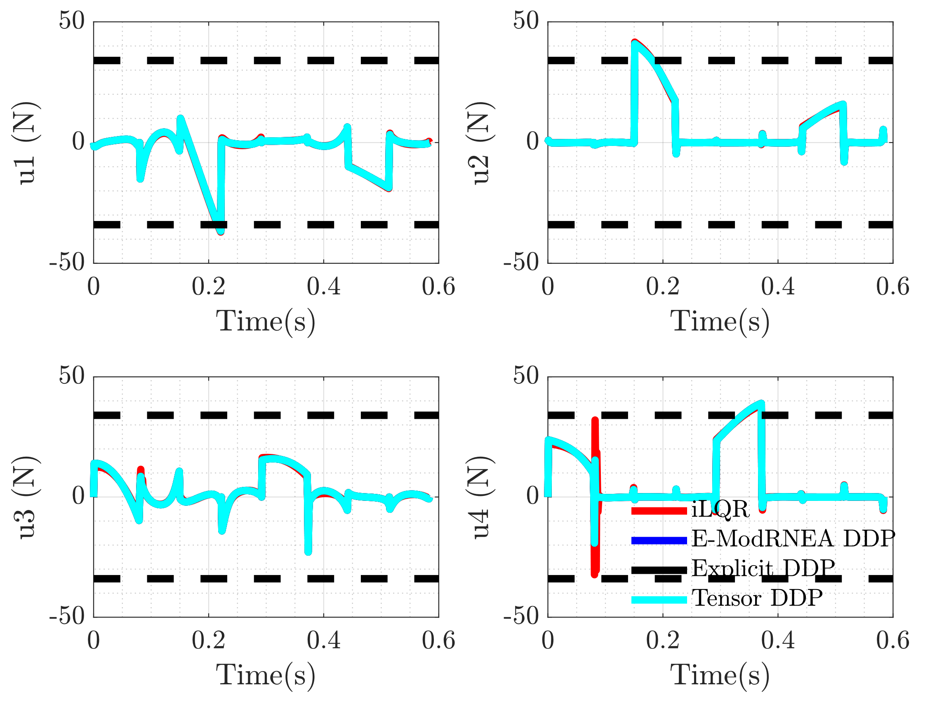
Control

Slide 6
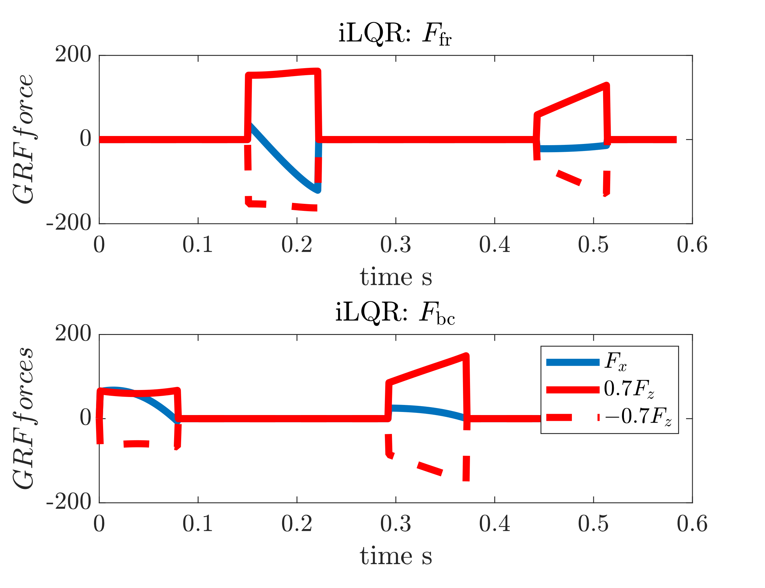

GRFs

Slide 7
Add noise to Optimized Control Trajectory
Use optimized trajectory and control as initial guess
Add weiner noise to controller
Run either iLQR/DDP for 20 iterations
Noise scaling
scaler = linspace(-2,2,15);
N = 585; dt = 1e-3;
dW = sqrt(dt)*randn(4,N); %weiner noise
W = cumsum(dW) * scaler(i);

Slide 8
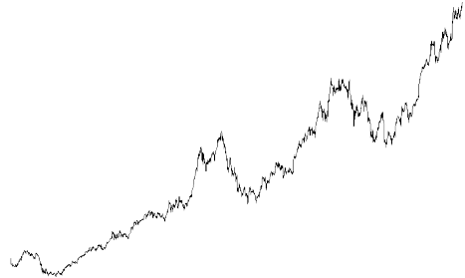
Add Noise to Trajectory
Trajectory
Control
Initial
Intermediate
Optimal
Control
Trajectory
Noise * Scalar
Run either iLQR/DDP for 20 iterations

Slide 9
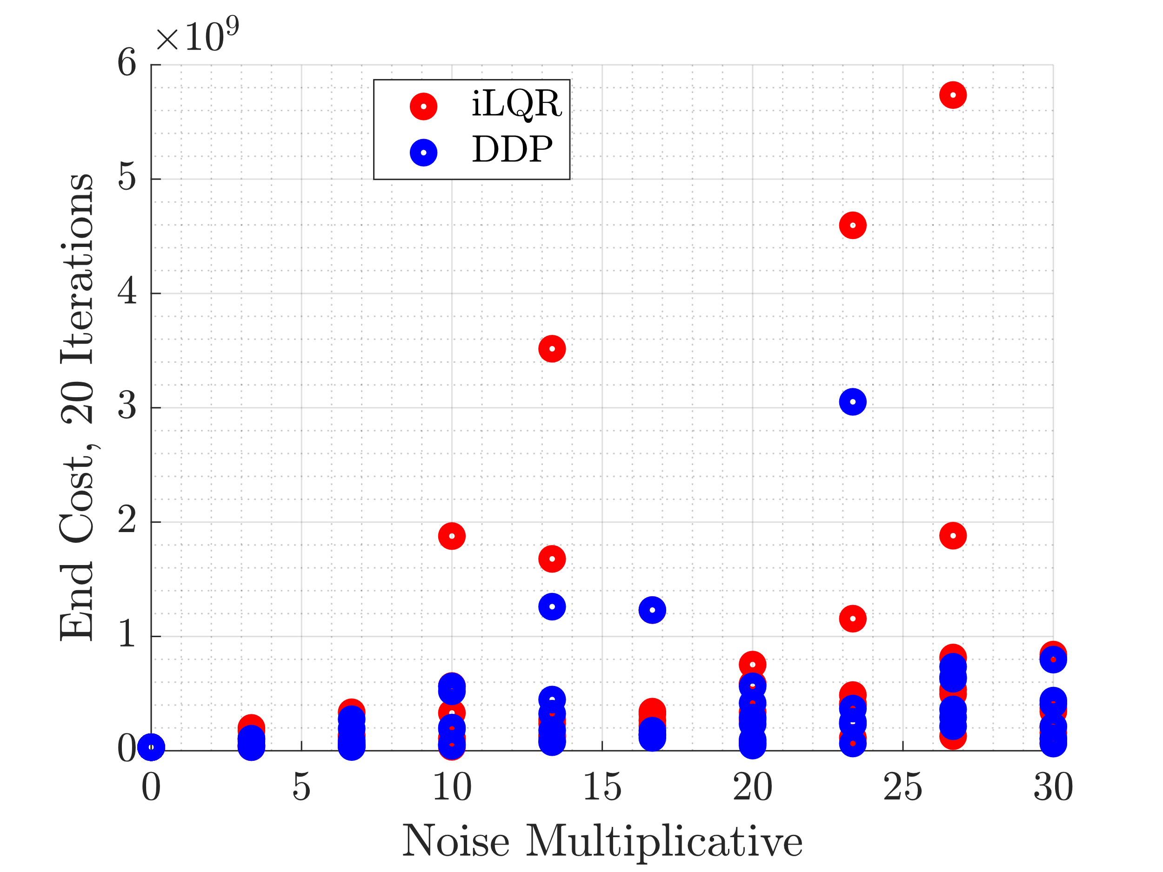
End Cost

Slide 10
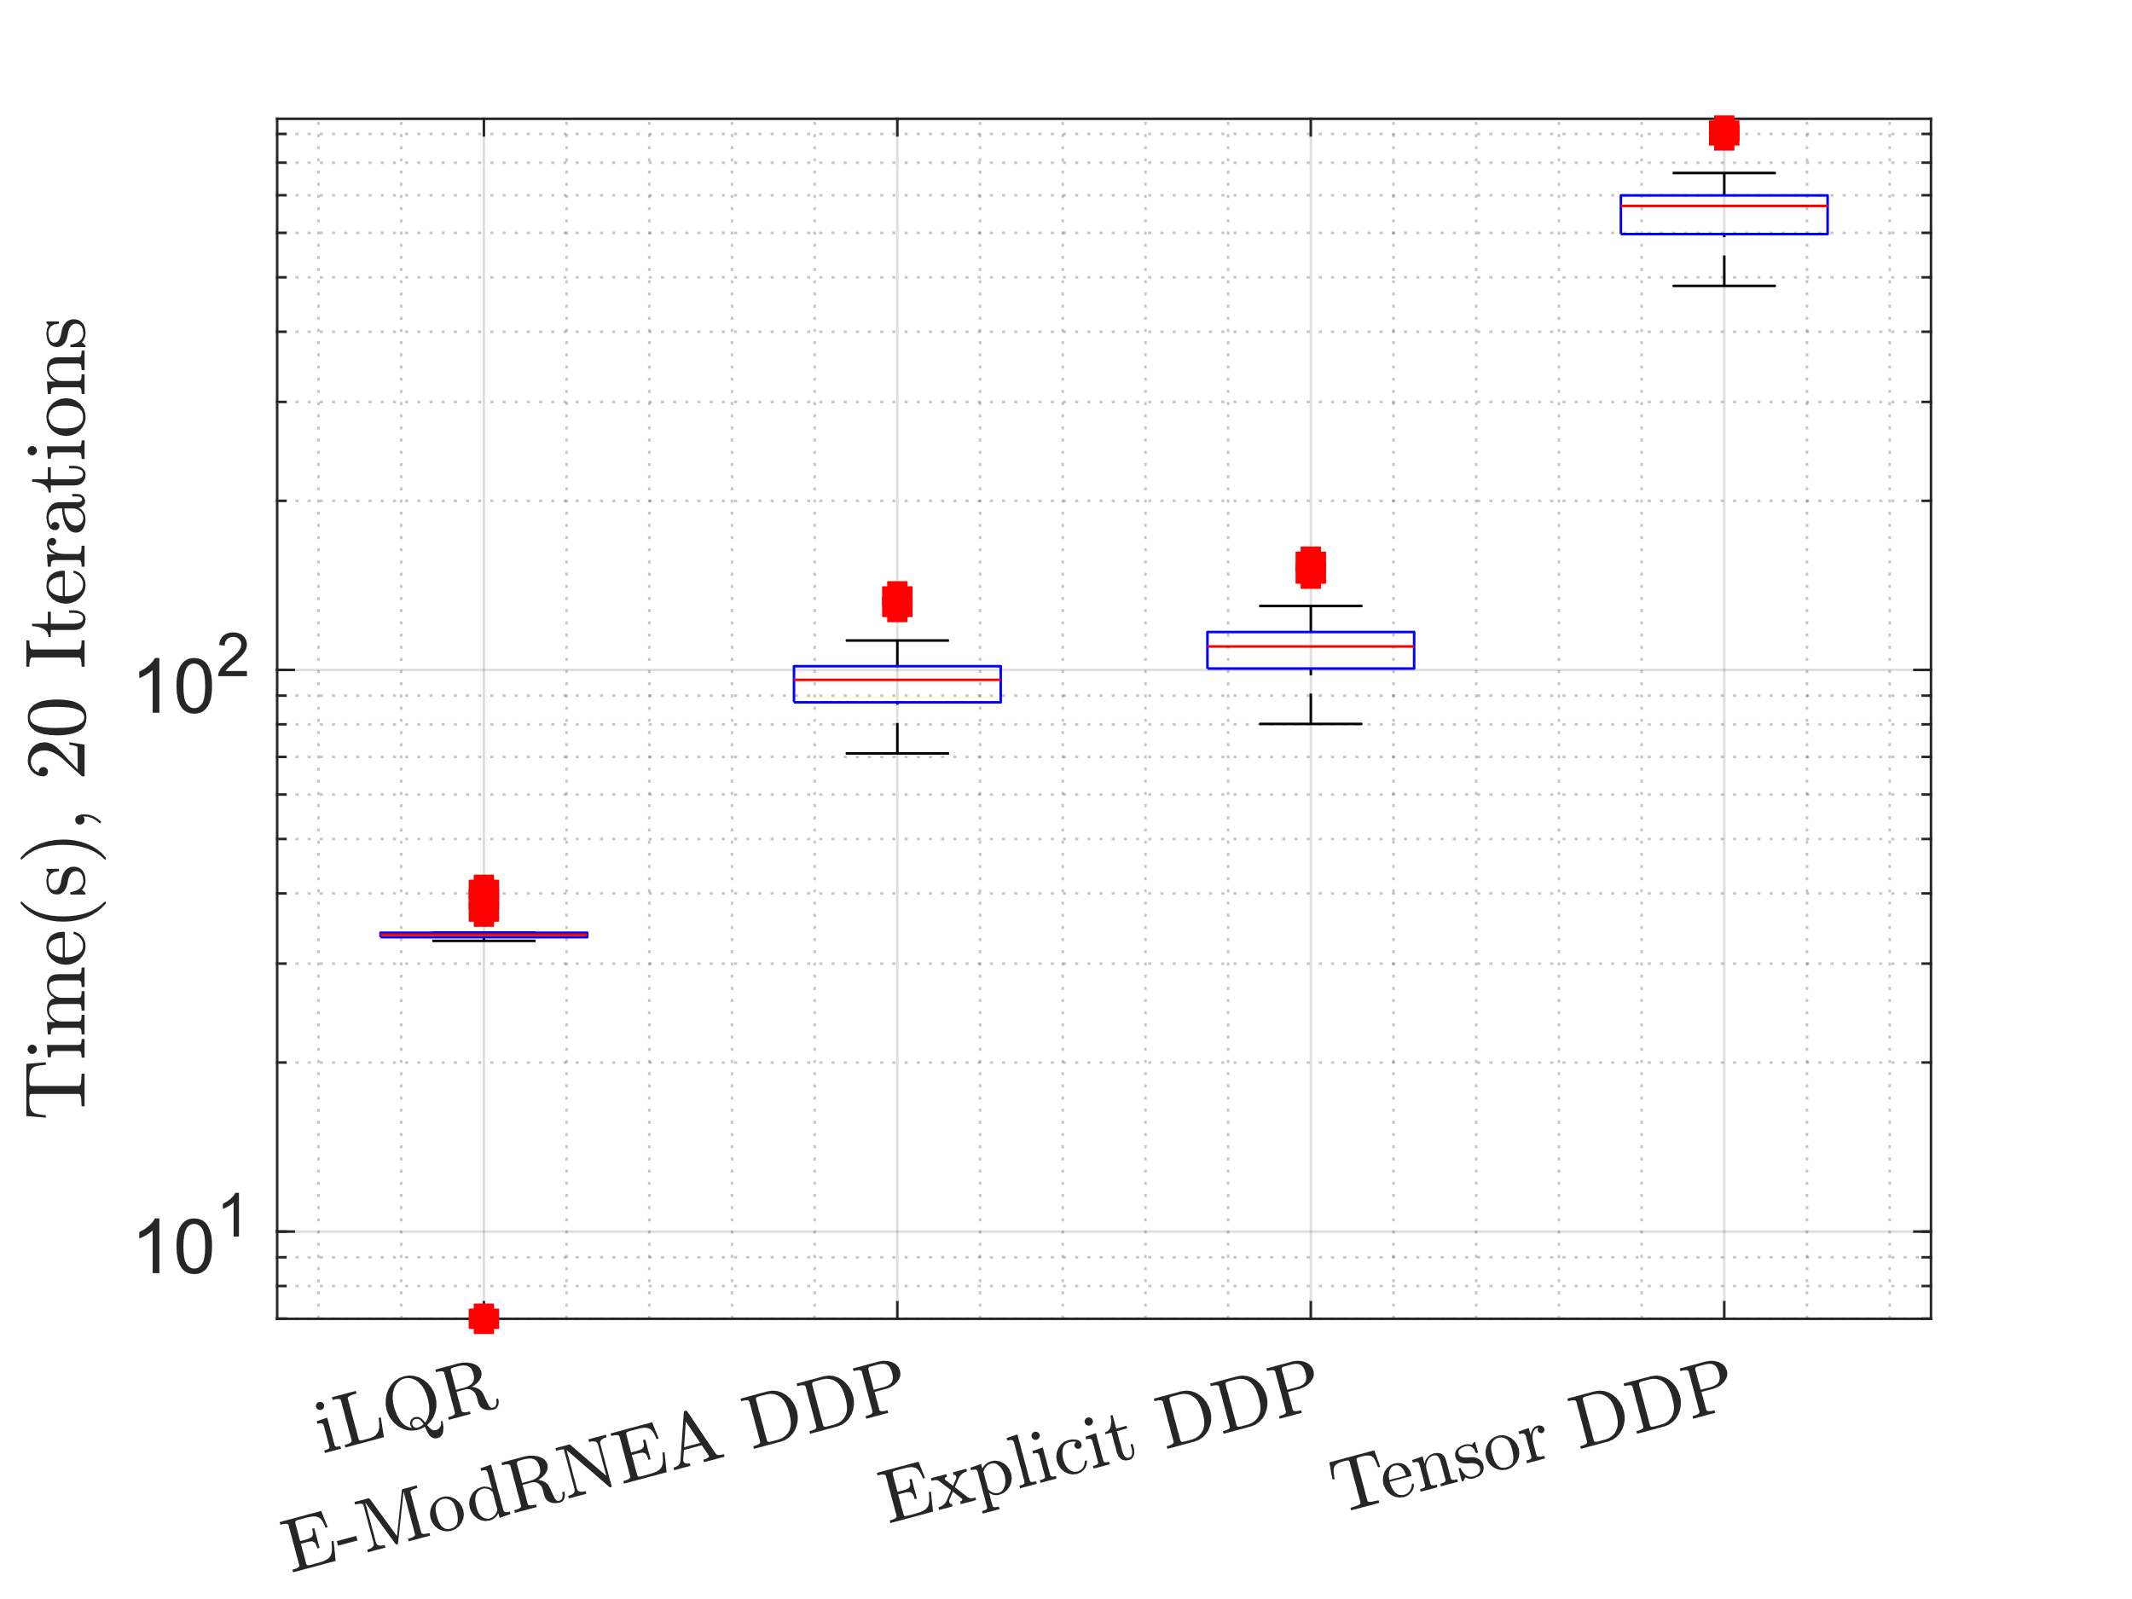
Time

Slide 11
Add noise to control
Use optimized trajectory and control as initial guess
Add weiner noise to controller
Run either iLQR/DDP for 150 iterations
Noise
N = 585; dt = 1e-3;
dW = sqrt(dt)*randn(4,N); %weiner noise
W = cumsum(dW);

Slide 12
Add Noise to Trajectory
Trajectory
Control
Initial
Intermediate
Optimal
Control
Trajectory
Noise * Large Scalar
Run either iLQR/DDP to convergence

Slide 13
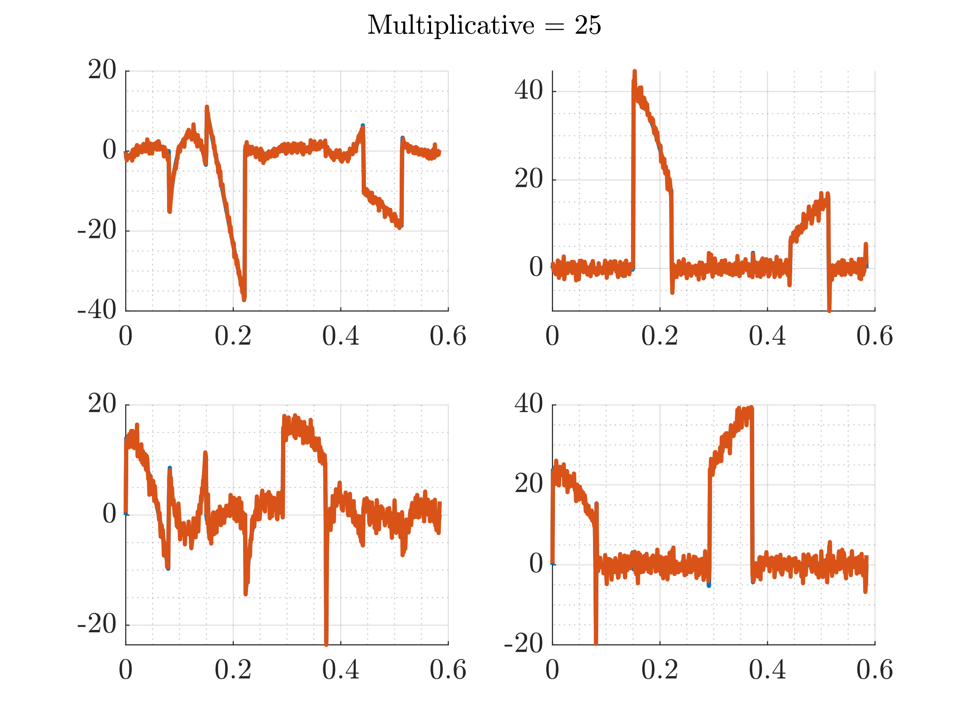
Add Noise Realization

Slide 14
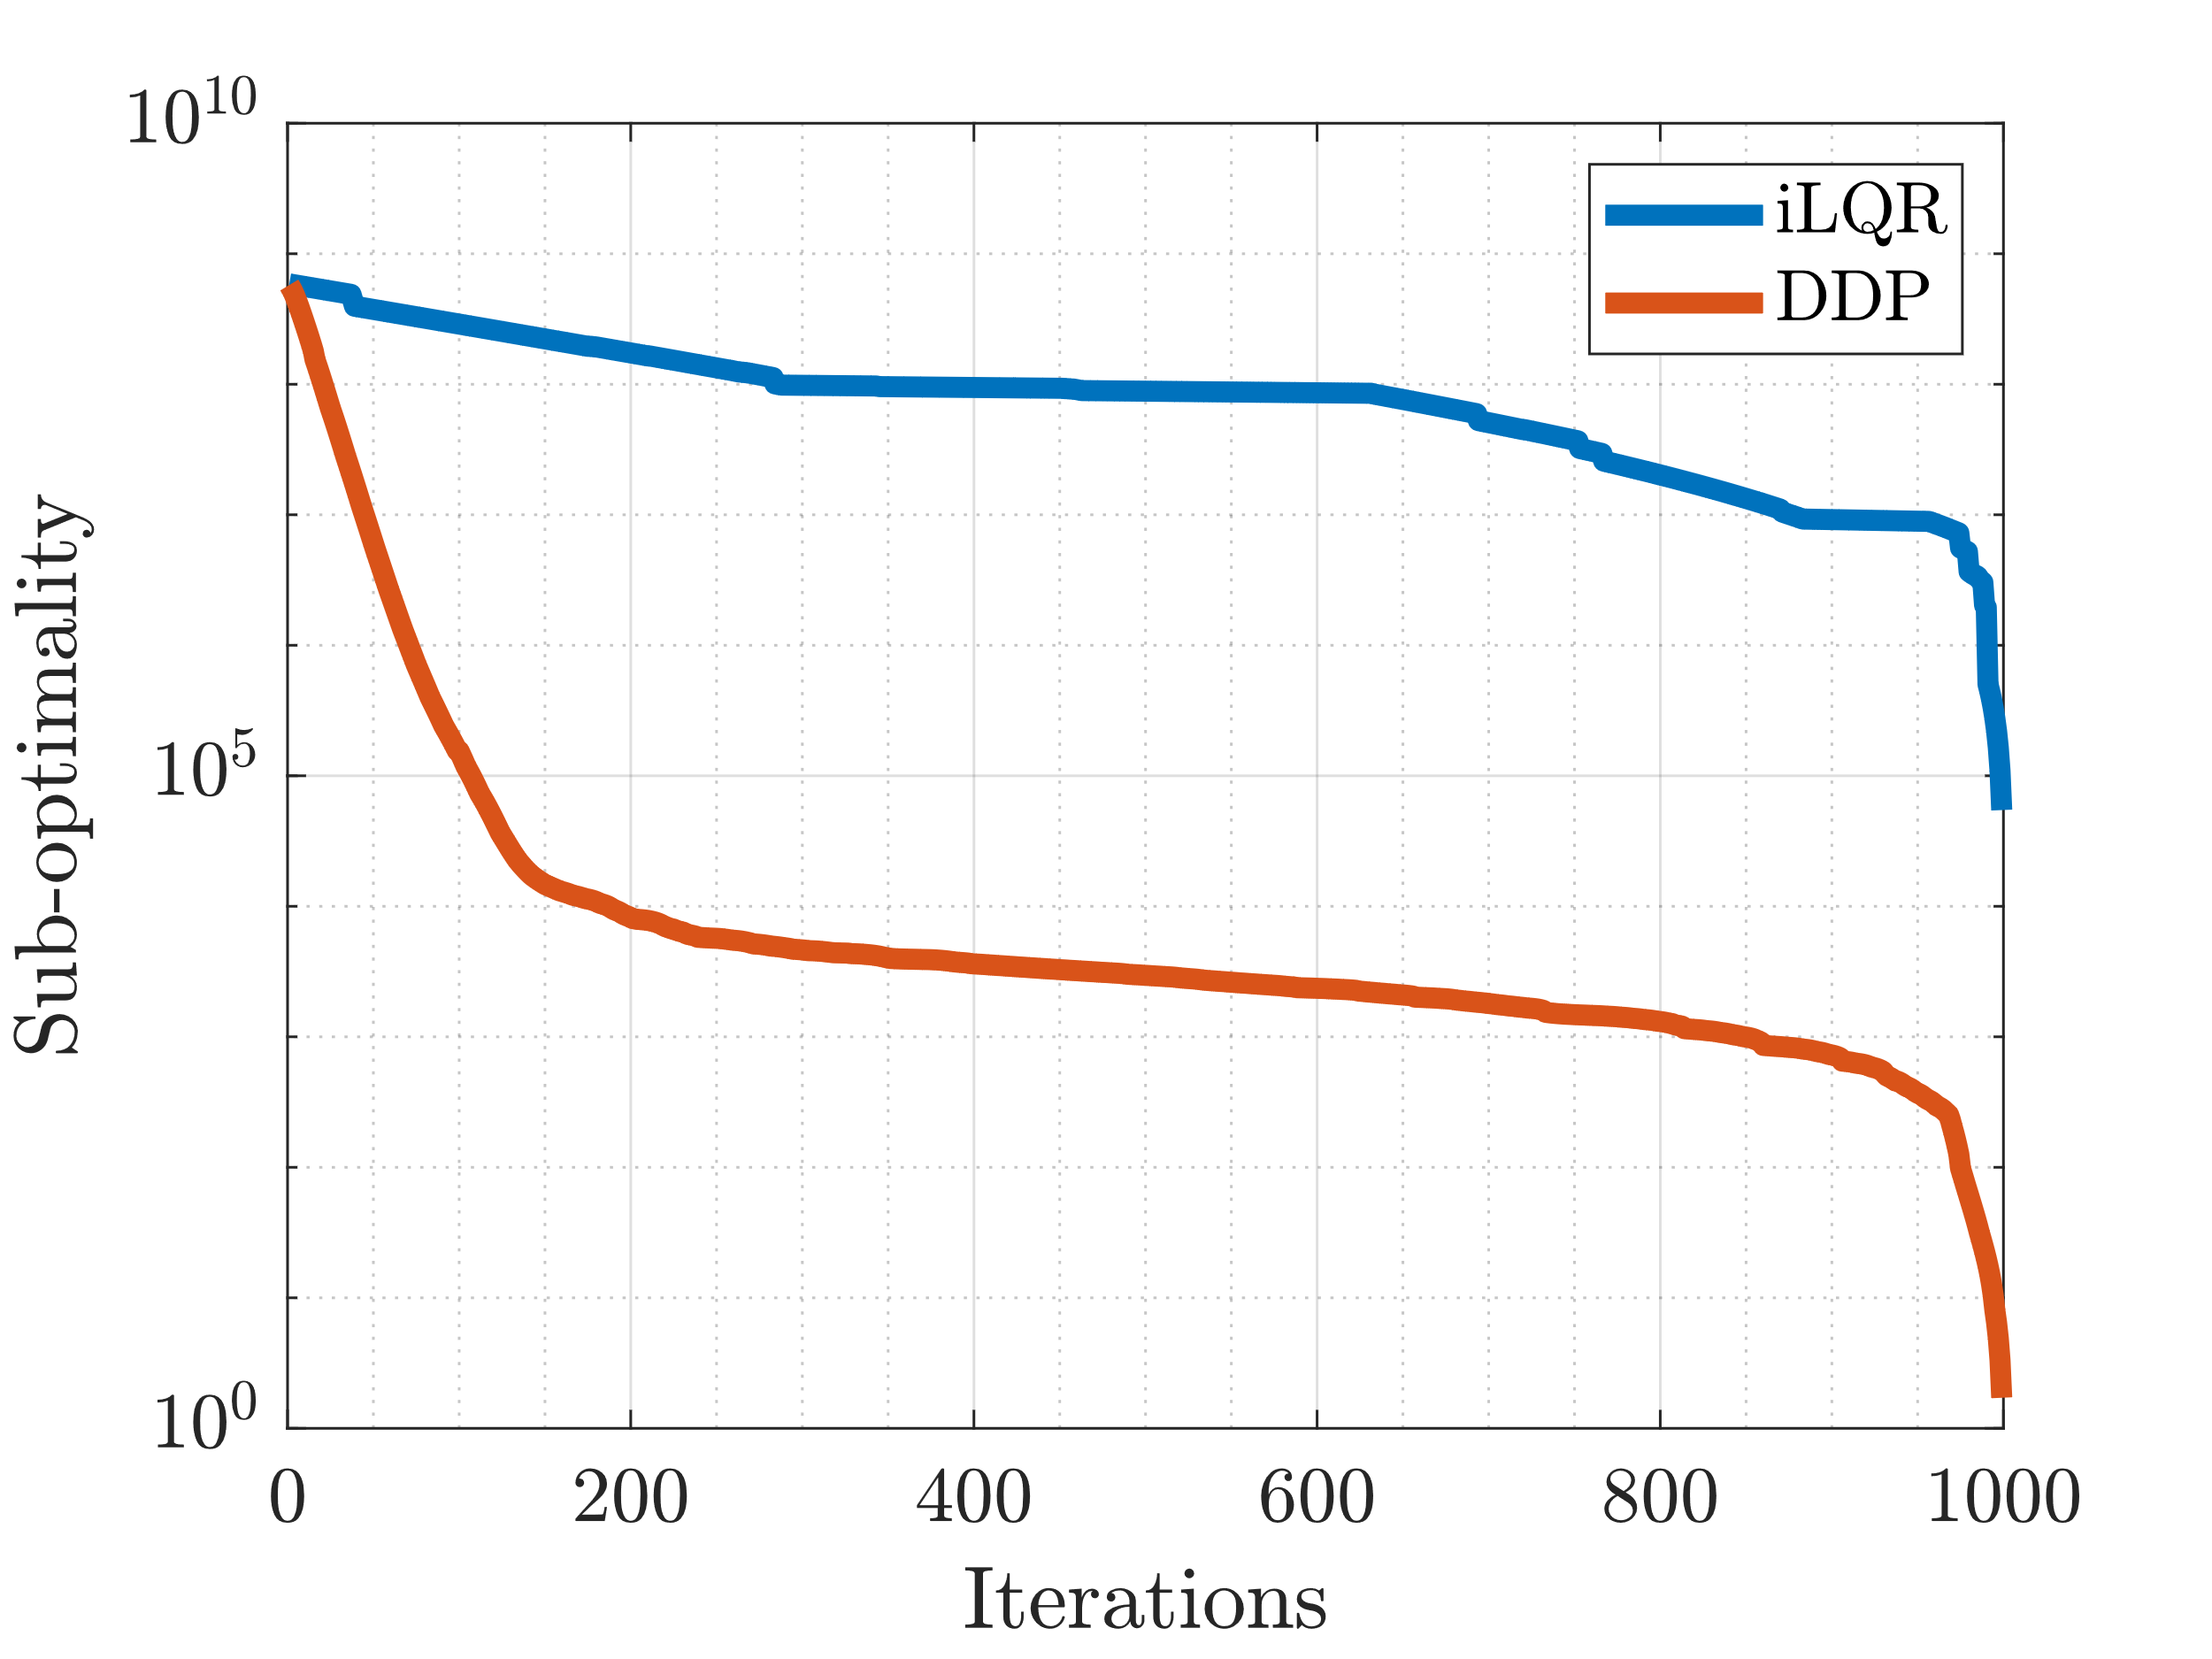
Suboptimality
Suboptimality = semiology(V – Vbar (end))

Slide 15
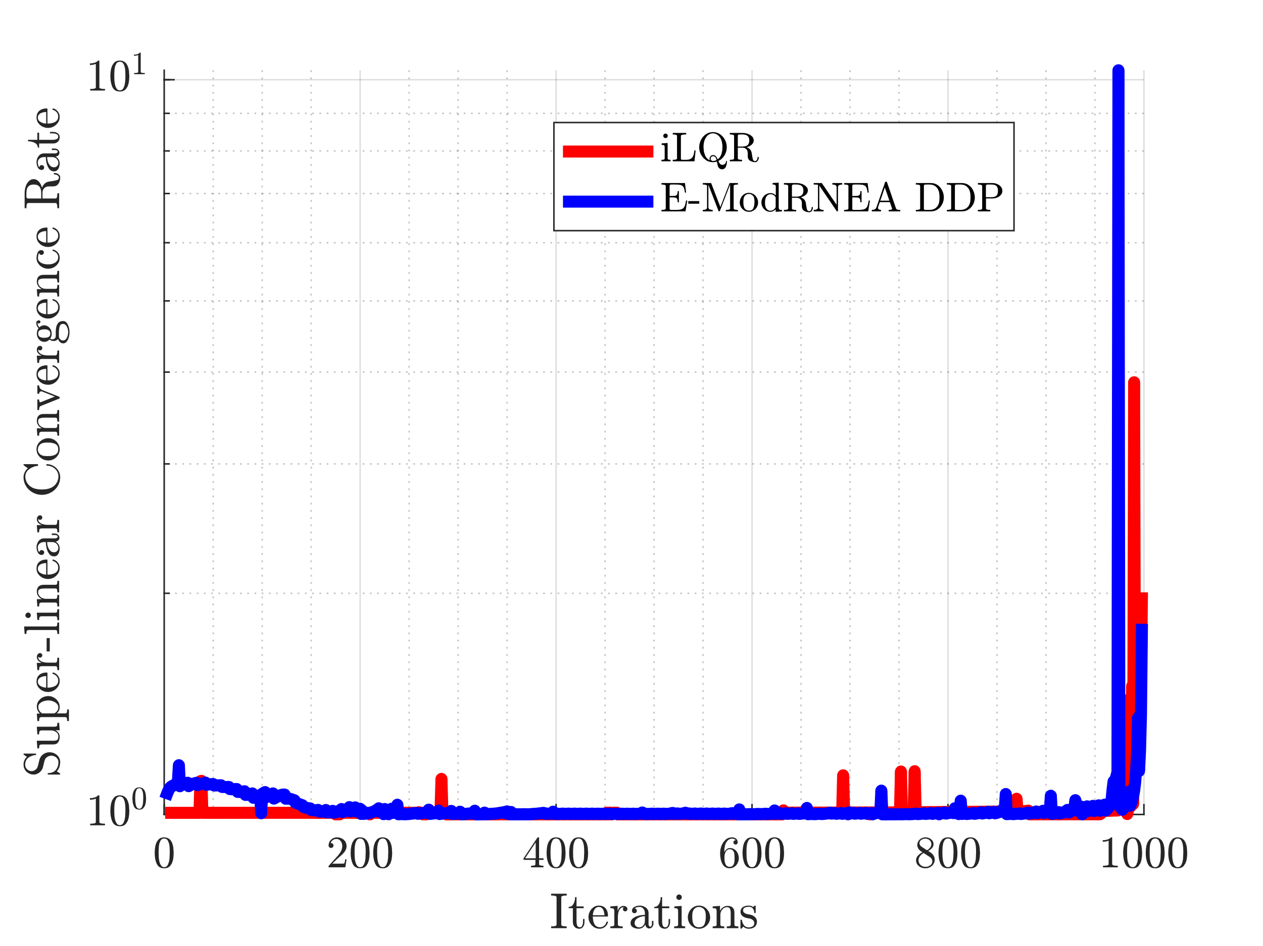
Convergence Rate: Superlinear

Slide 16
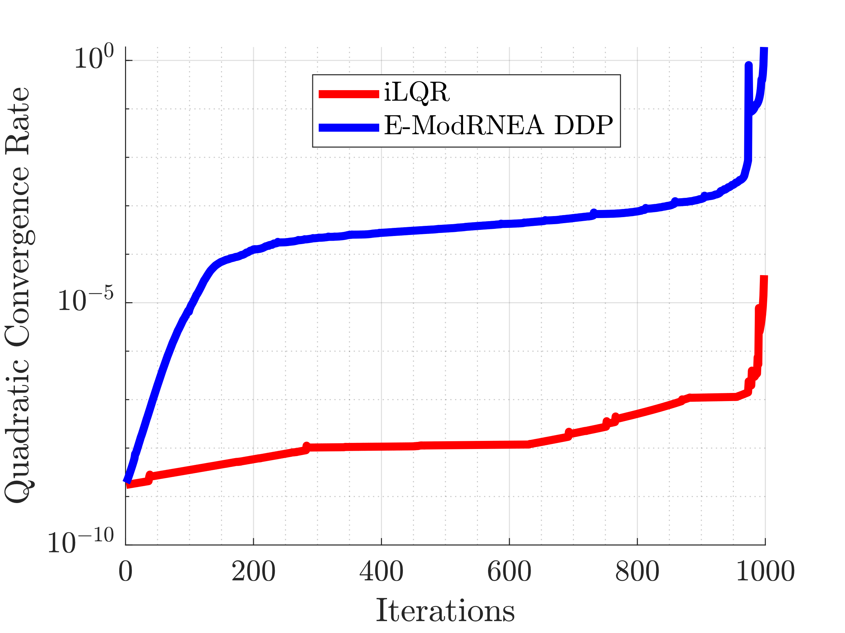
Convergence Rate: Quadratic

Slide 17
Paper
Writing results section
Figures from this presentation

